Slide 1
Corona Virus
SQL Project

Slide 2
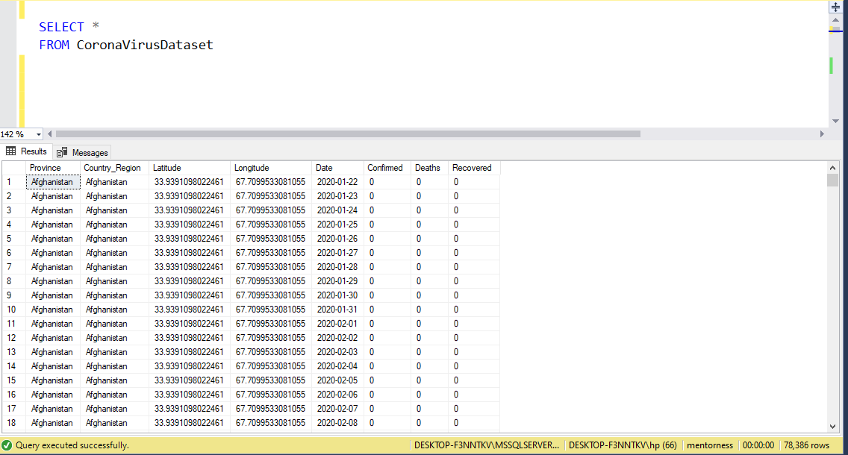
Exploration
Exp loration

Slide 3
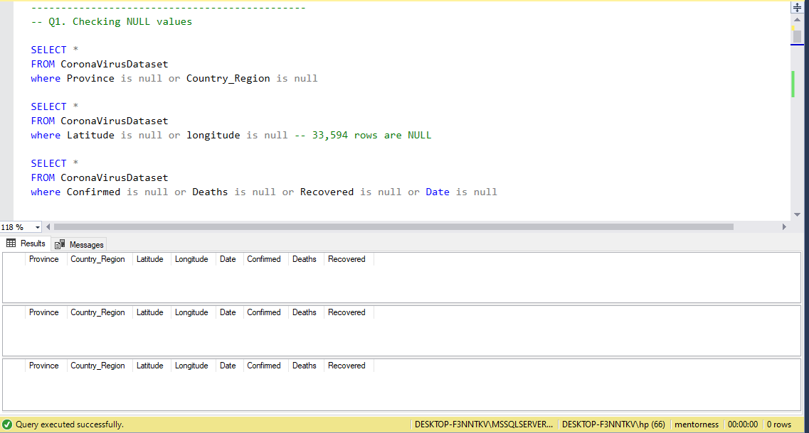
Checking Null Values

Slide 4
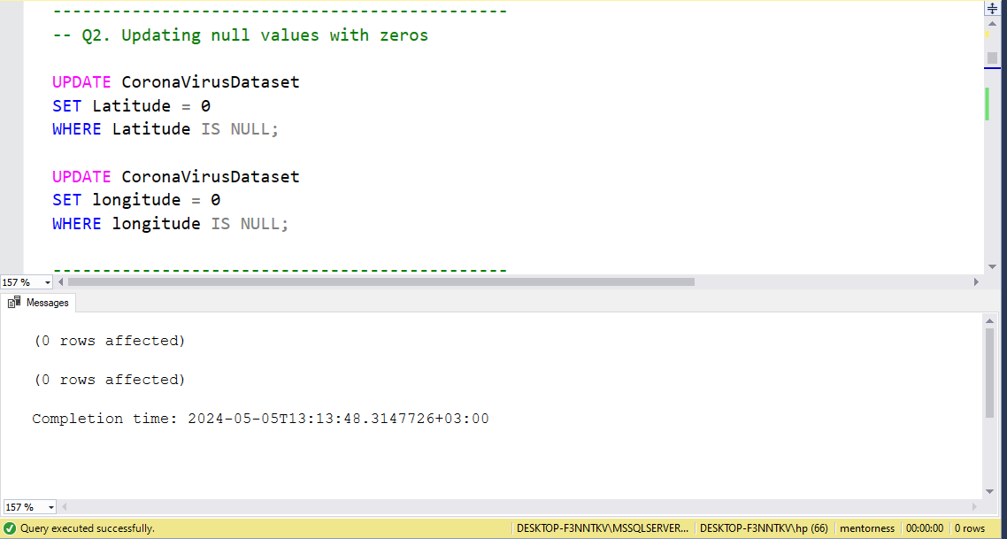
- UPDATE - SET

Slide 5
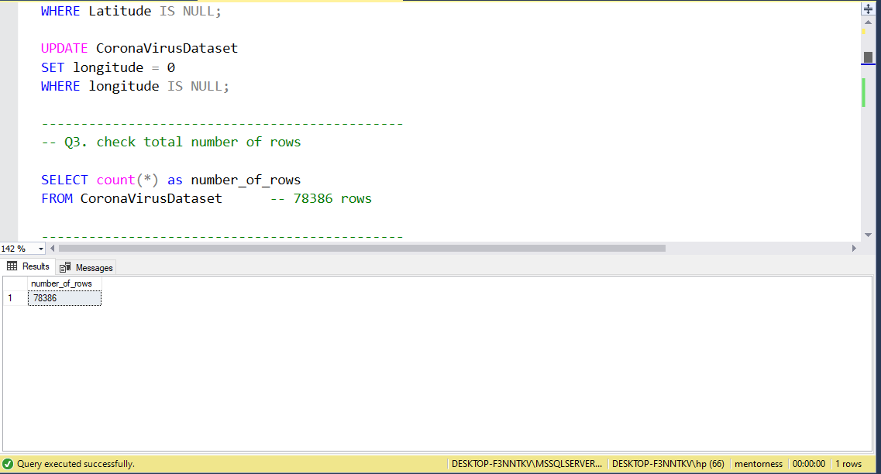
- COUNT

Slide 6
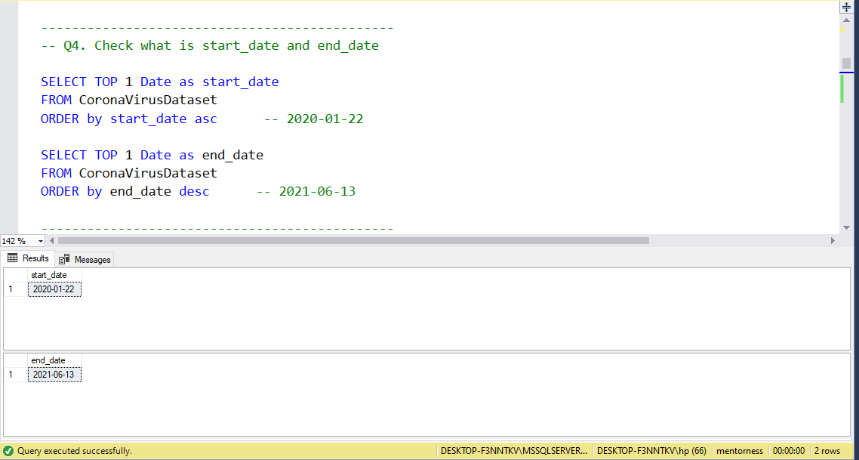
- TOP - ORDER BY

Slide 7
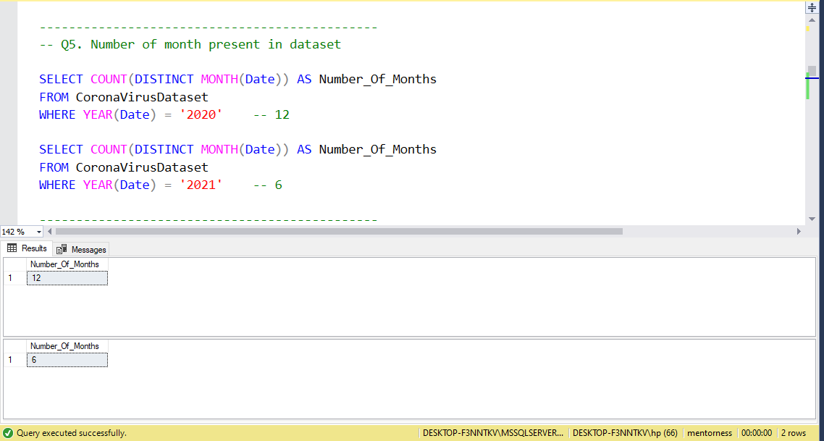
- COUNT - DISTINCT - MONTH - YEAR

Slide 8
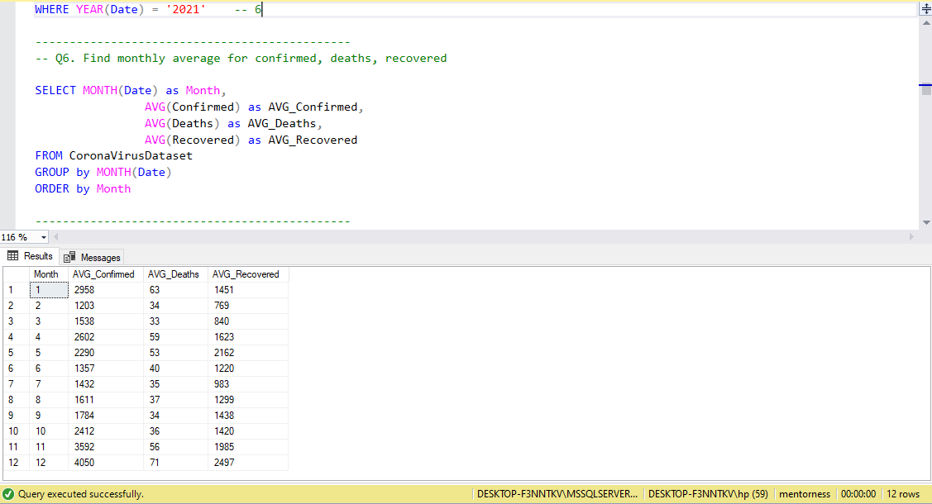
- AVG - DISTINCT - MONTH - YEAR
- ORDER BY - GROUP BY

Slide 9
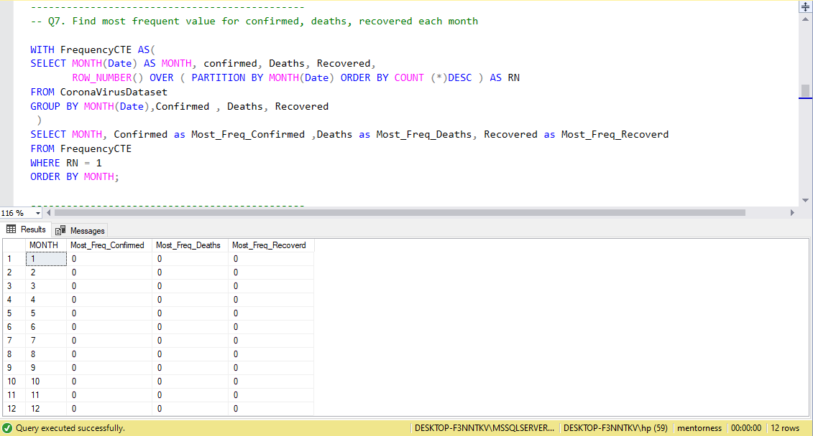
- CTE - MONTH - ROW_NUMBER PARTITION BY - YEAR
- ORDER BY - GROUP BY

Slide 10
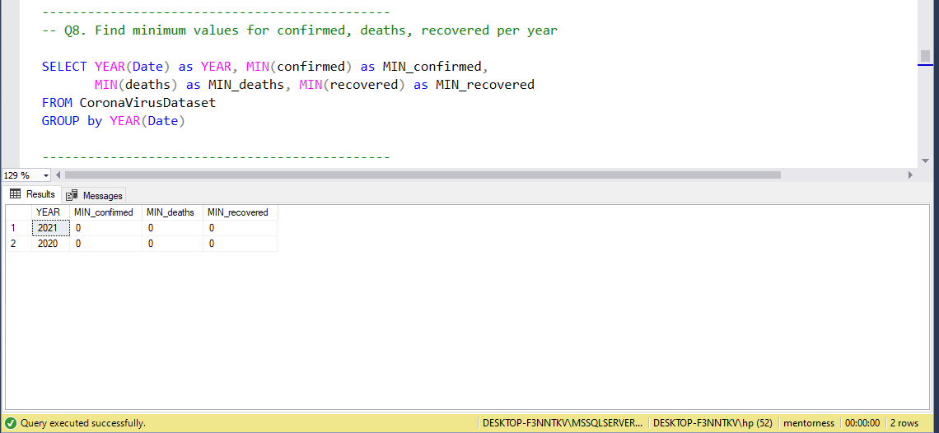
- MIN - YEAR - GROUP BY

Slide 11
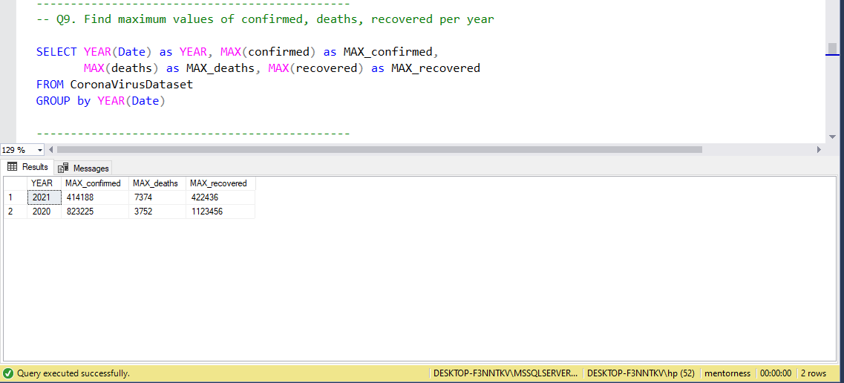
- MAX - YEAR - GROUP BY

Slide 12
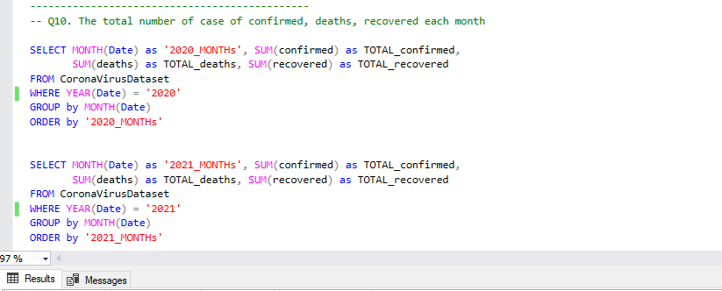
- MONTH - SUM - YEAR - GROUP BY
- ORDER BY

Slide 13
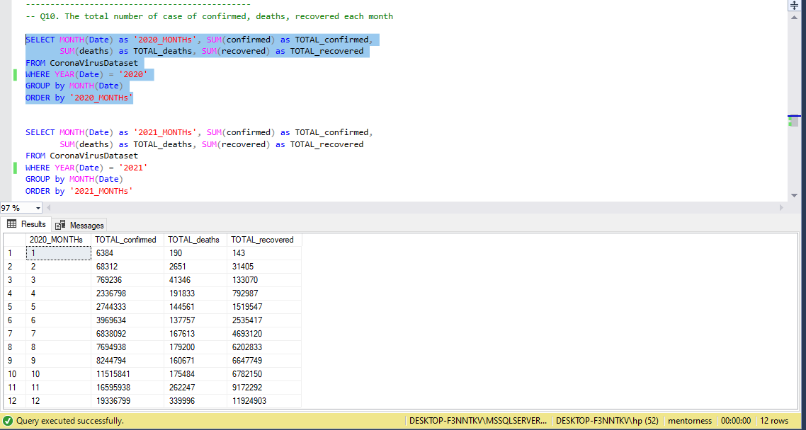
- MONTH - SUM - YEAR - GROUP BY
- ORDER BY

Slide 14
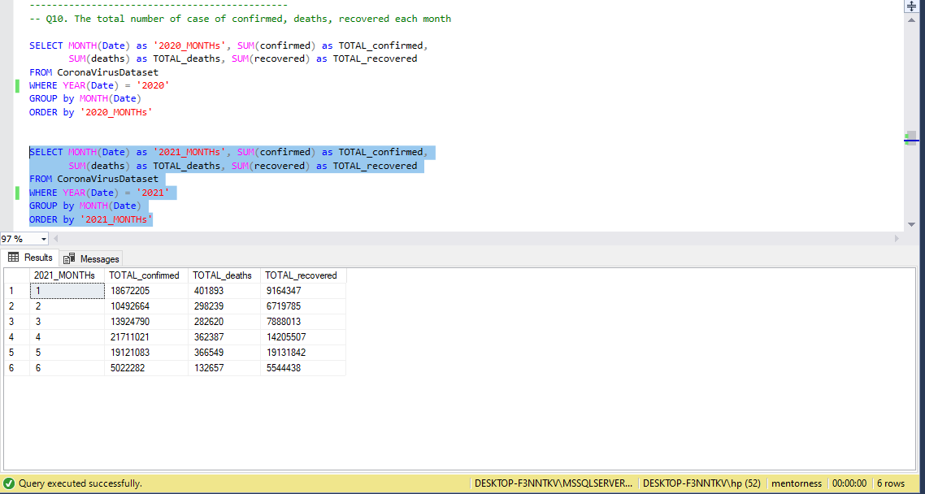
- MONTH - SUM - YEAR - GROUP BY
- ORDER BY

Slide 15
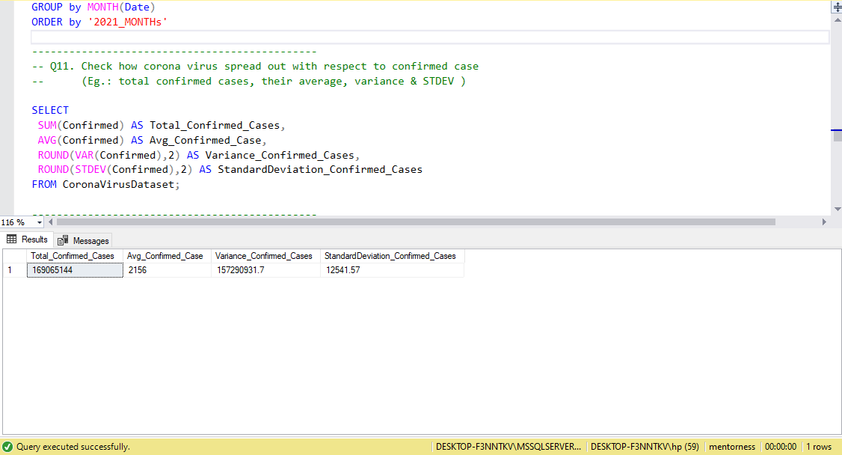
- SUM - AVG - ROUND
- VAR - STDEV

Slide 16
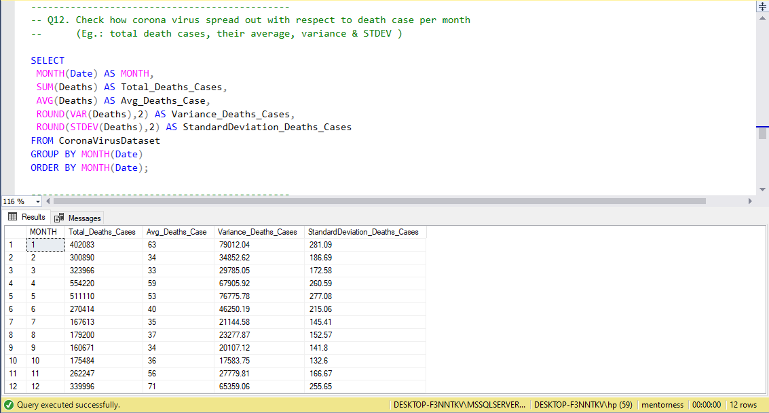
- MONTH - SUM - AVG - ROUND
- VAR - STDEV - GROUP BY - ORDER BY

Slide 17
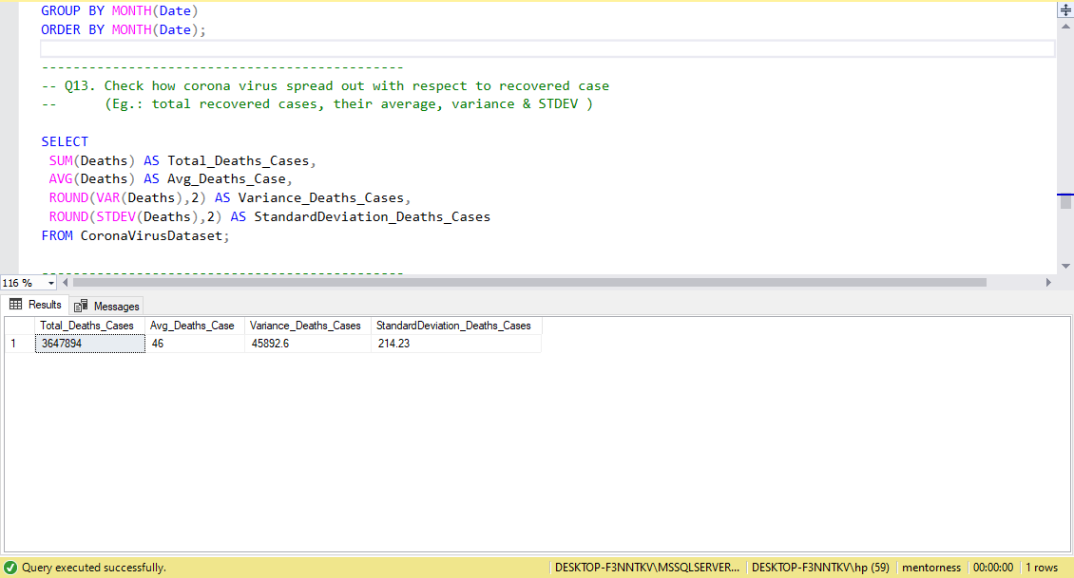
- SUM - AVG - ROUND
- VAR - STDEV

Slide 18
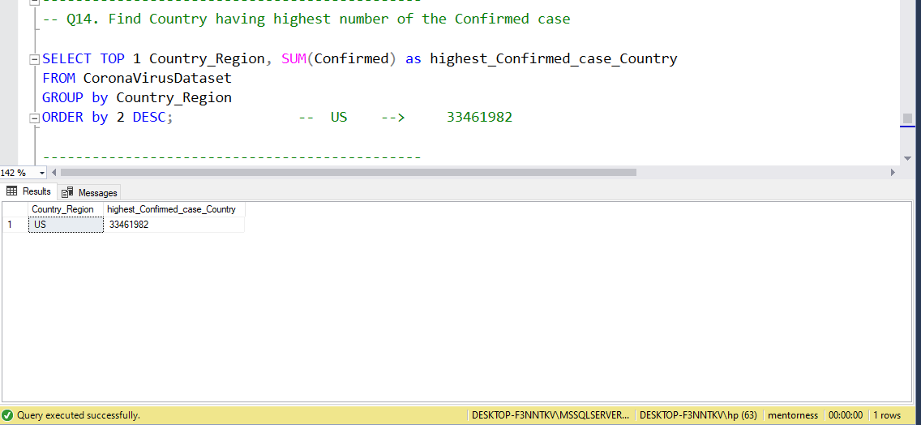
- TOP - SUM - GROUP BY
- ORDER BY

Slide 19
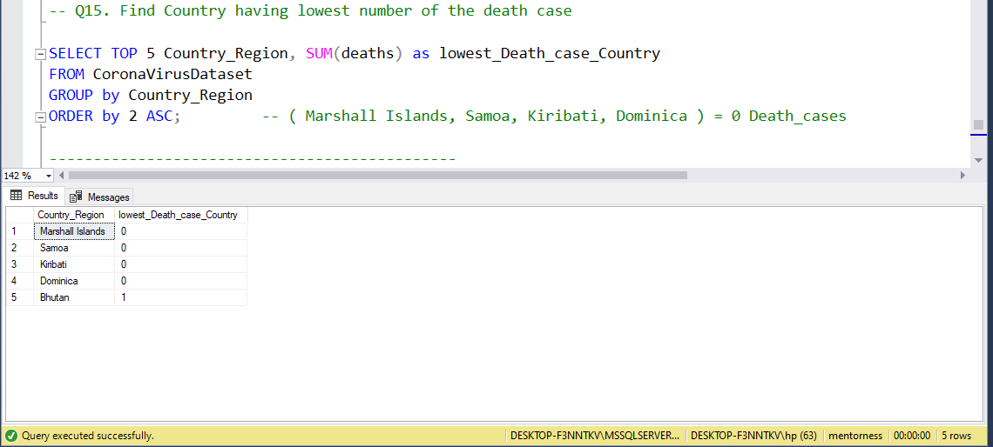
- TOP - SUM - GROUP BY
- ORDER BY

Slide 20
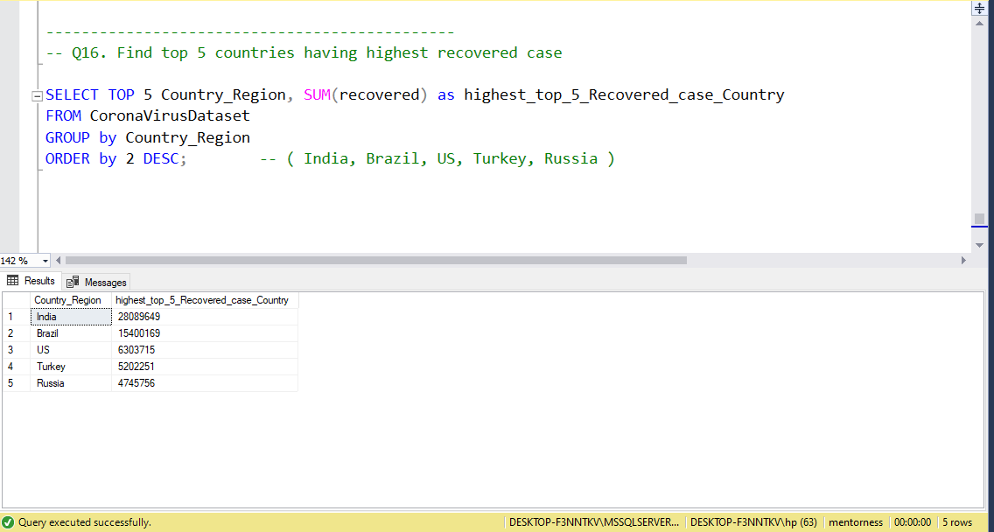
- TOP - SUM - GROUP BY
- ORDER BY

Slide 21
Thank You !

